Slide 1

2022 Platform 개발자 Academy
Project Activity – Configuration & Customization

Slide 2
TABLE OF CONTENTS
I. Time Schedule
II. Project Overview
III. Configuration
IV. Customization

Slide 3
Time schedule

Slide 4
Agenda
Date | Time | Session | Description | Remark
11/22 | 09:30 ~ 12:00 | Project | 제안 / 프로젝트란? | Project Methodology
 | 13:00 ~ 17:00 |  | 솔루션 개발자 역할 | Solution Architecture
11/23 | 09:30 ~ 12:00 | Configuration | Administrator 역할 (User, License,..) | Center operation
 | 13:00 ~ 17:00 |  | 솔루션 구조 이해 (MQL) | Data Modeling
11/24 | 09:30 ~ 12:00 | Customization I - Client | WAS 구조 이해
 | 13:00 ~ 17:00 |  | 메뉴 별 솔루션 모델 구조 | Menu, Command
11/25 | 09:30 ~ 12:00 |  | 신규 생성 UI 만들기 | form
 | 13:00 ~ 17:00 |  | 신규 리스트 UI 만들기 | Indented Table
11/29 | 09:30 ~ 12:00 | Customization II - Server | 서버 로직 반영하기 (채번) | Trigger, Number generator
 | 13:00 ~ 17:00 |  | 서버 프로그랭 | JPO
11/30 | 09:30 ~ 12:00 |  | 검색 엔진 이해하기 (exalead) | Searchindex, config.xml
 | 13:00 ~ 17:00 |  | 개발 할 때 지켜야 하는 룰 | Code Standardization

Slide 5
Project overview

Slide 6
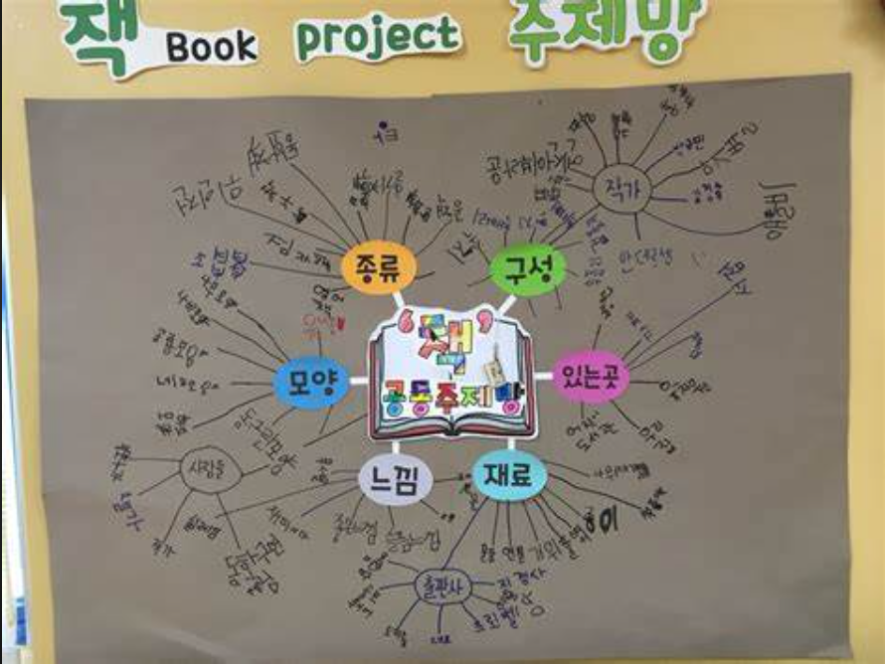
Value engagement
PROJECT ??
PROPOSAL ??

Slide 7
Configuration

Slide 8
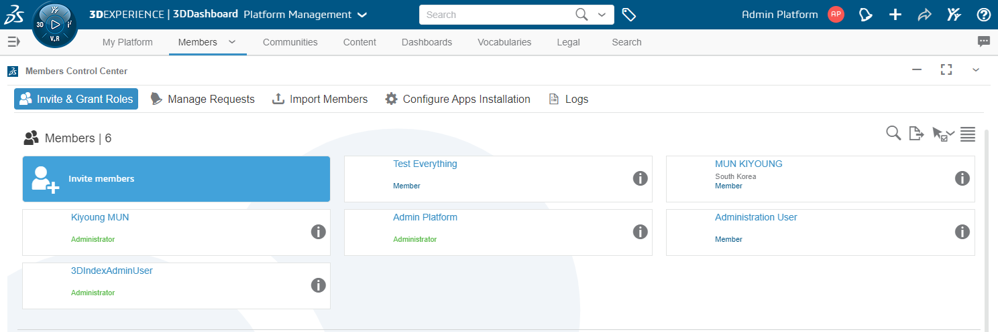
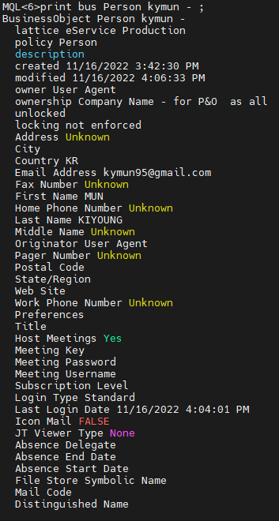
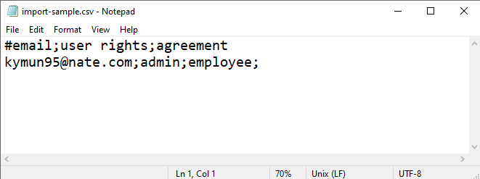
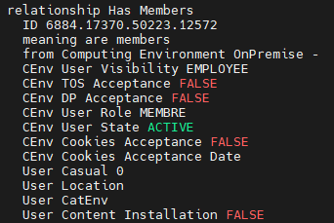
configuration
User Register

Slide 9
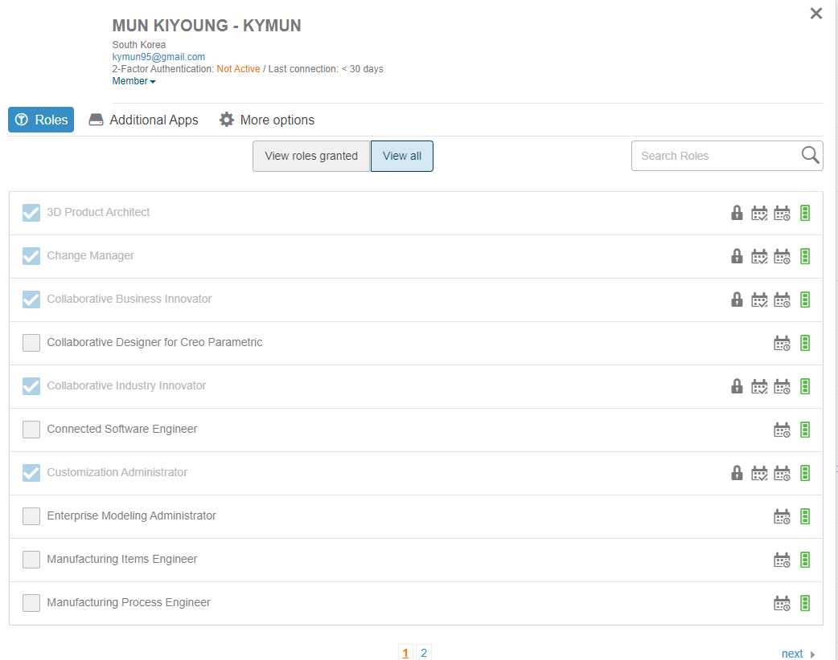
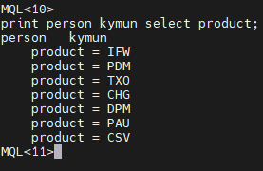
configuration
License Assign

Slide 10
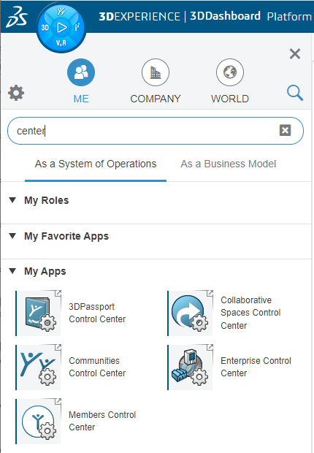
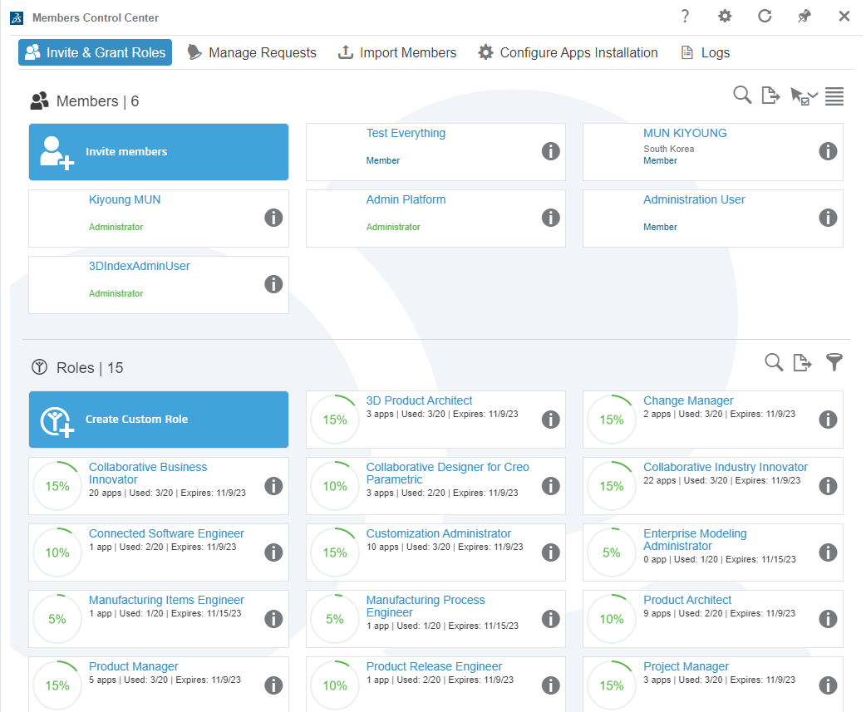
configuration
Member Control

Slide 11
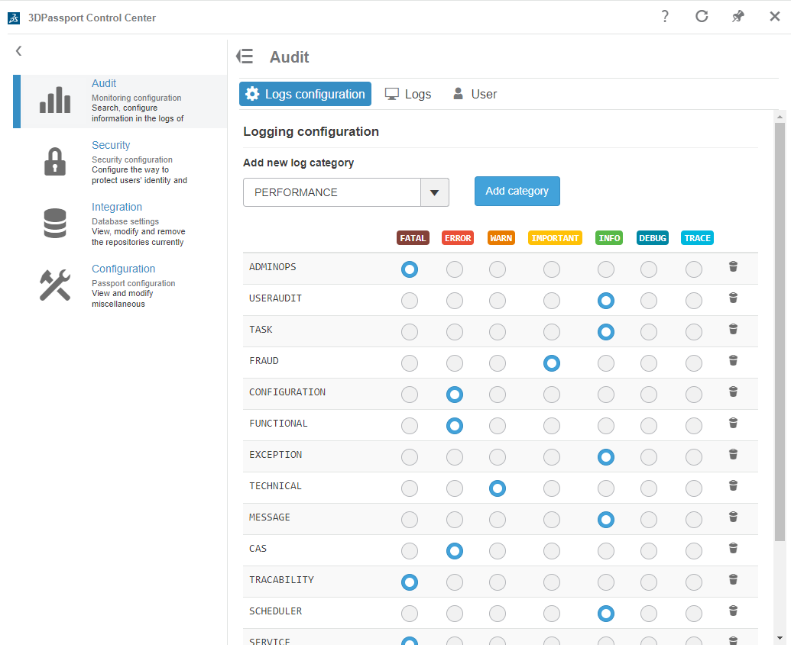
configuration
3DPassport

Slide 12
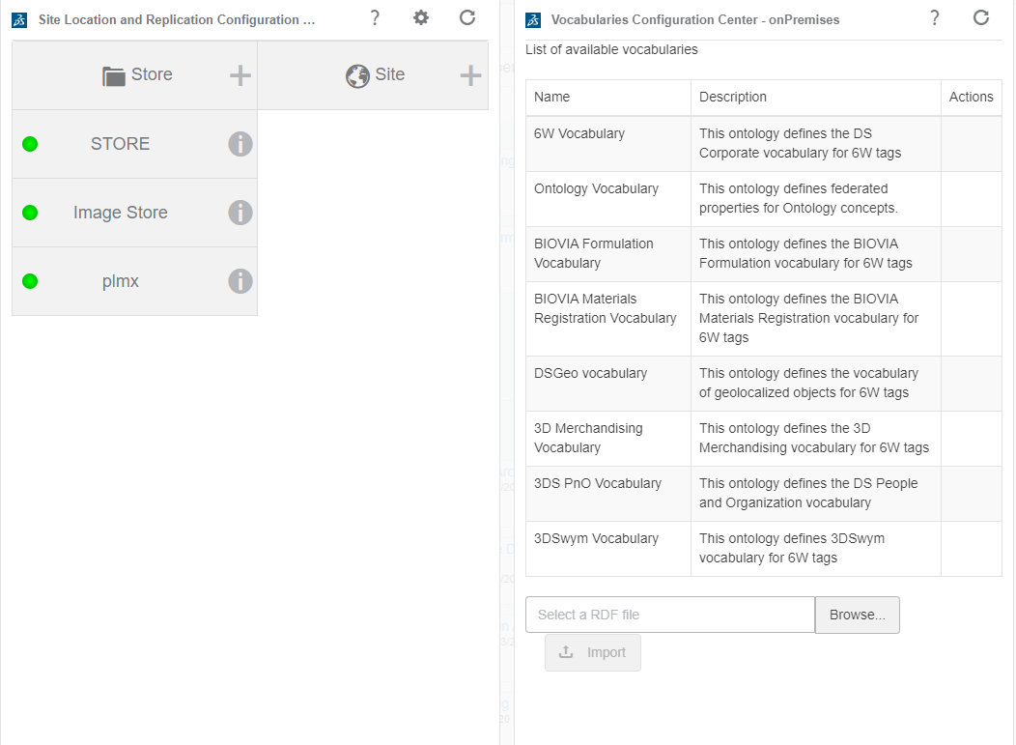
configuration
User Register

Slide 13
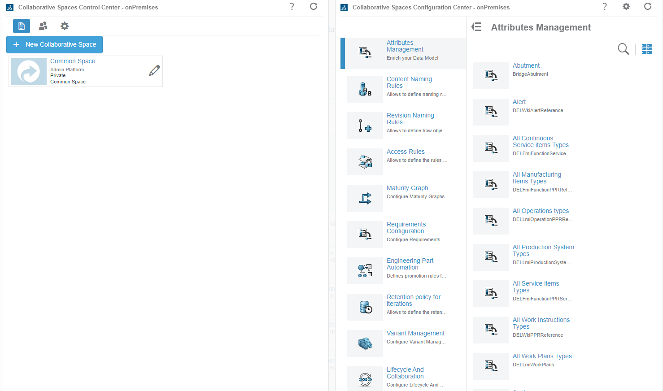
configuration
Collaborative Space Control

Slide 14
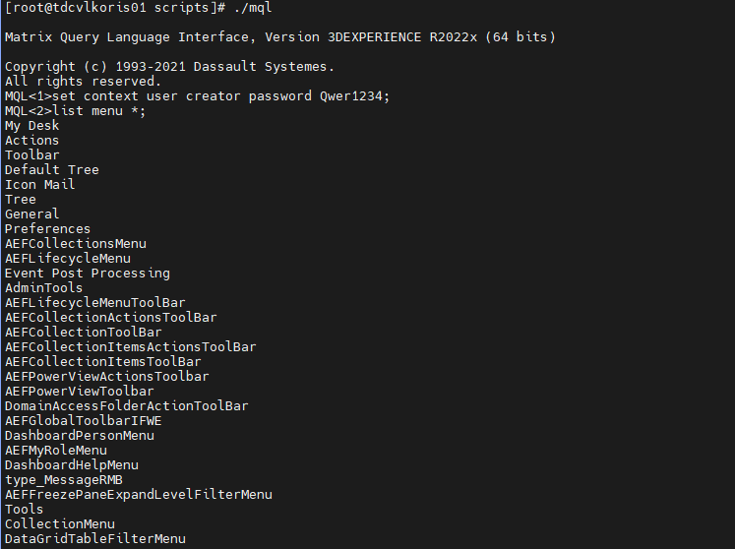
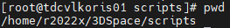
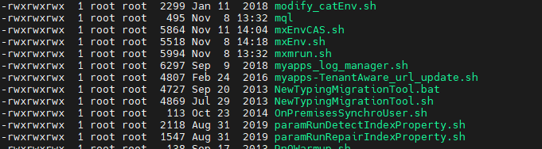
configuration
Data Modeling - MQL
MQL<1> help XXXX
https://help.3ds.com/2022x/English/DSDoc/MqlReferenceMap/mql-c-ov.htm?contextscope=onpremise&id=e050806f489940eab6096327a9971d3b

Slide 15
configuration
Data Modeling for Data(Business Object)
Policy
Policy
TYPE
TYPE
Relationship
Attribute
Attribute
Attribute

Slide 16
configuration
Data Modeling for UI
Portal
Channel
Channel
Menu
Command
Menu
Command
.
.
.
.
.
.
Command
Command
.
.
.
.
Command
Command
Command
Command

Slide 17
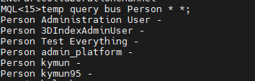
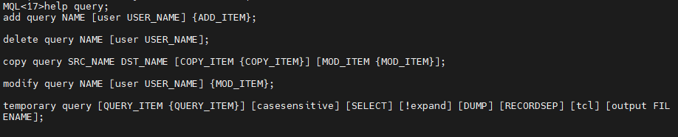
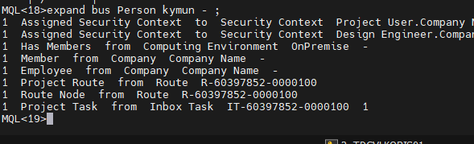
configuration
Business Object Query

Slide 18
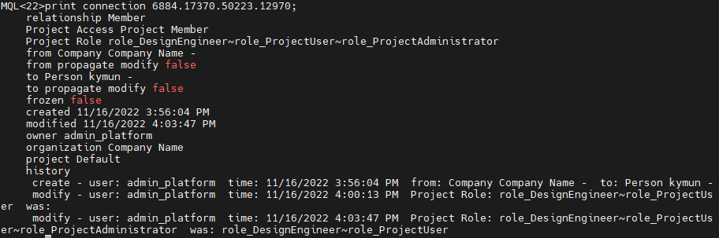
configuration
Relationship Query

Slide 19
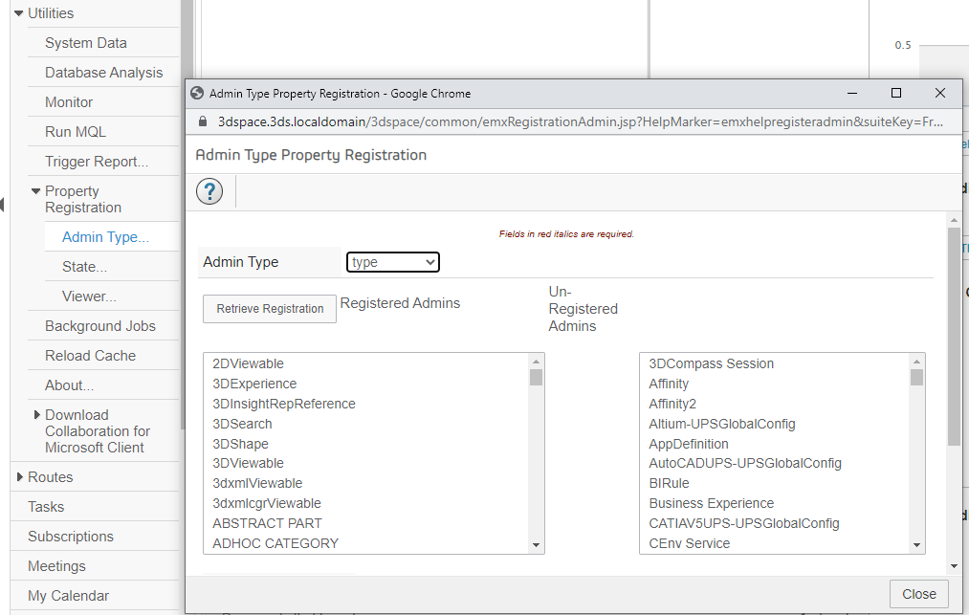
configuration
Property Registration

Slide 20
Customization I - Client

Slide 21
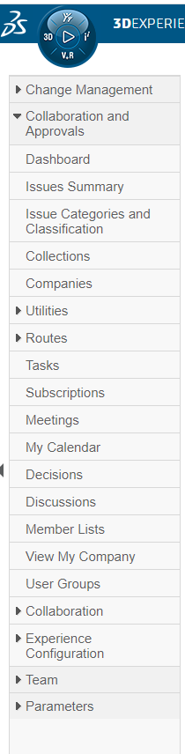
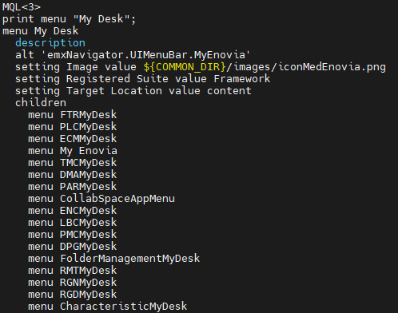
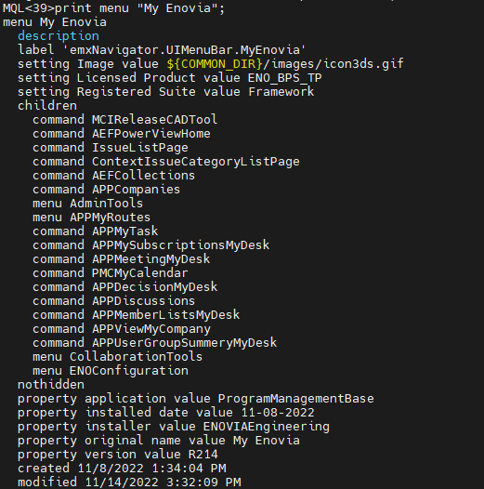
Customization I - client
UI Mapping

Slide 22
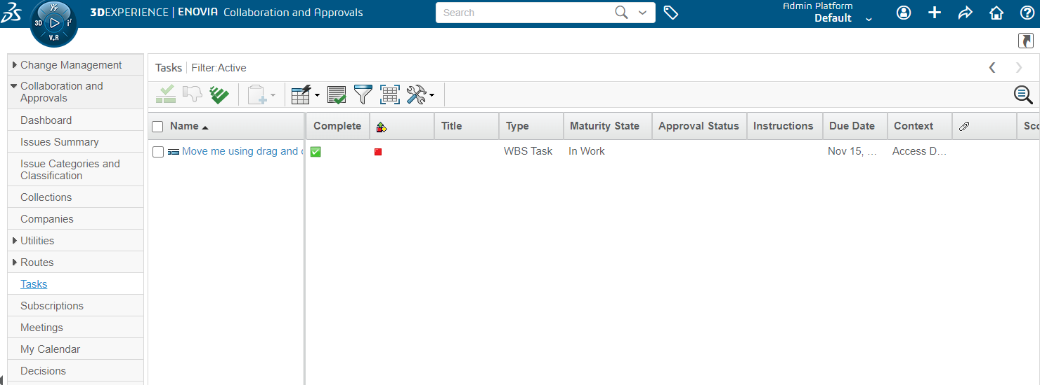
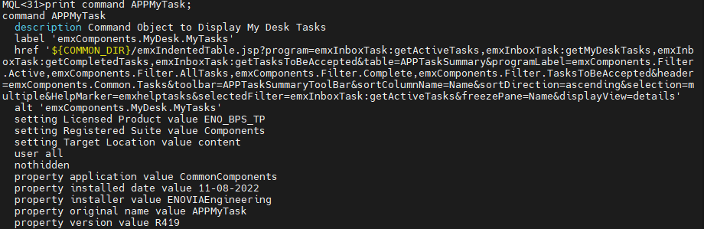
Customization I - client
UI Mapping

Slide 23
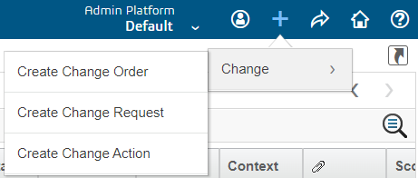
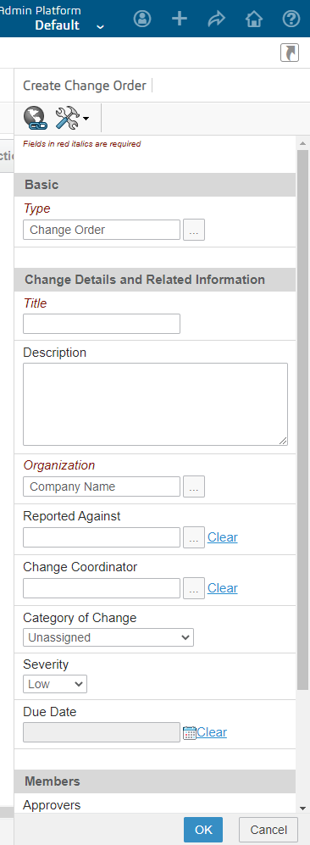
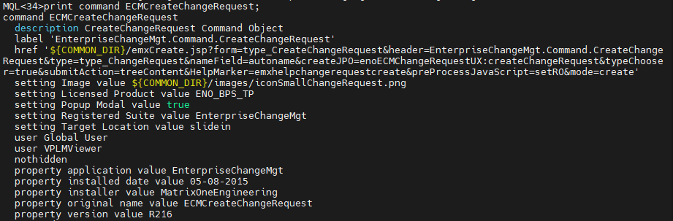
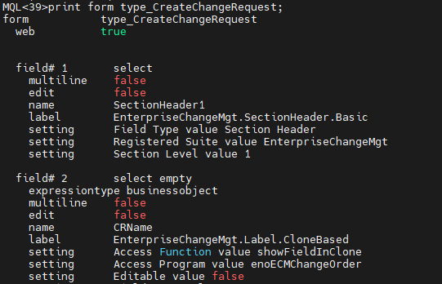
Customization I - client
UI Mapping

Slide 24
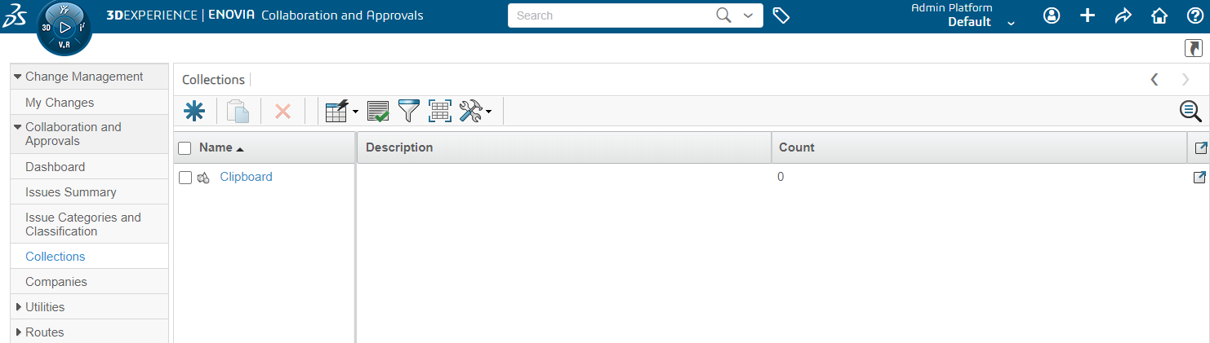
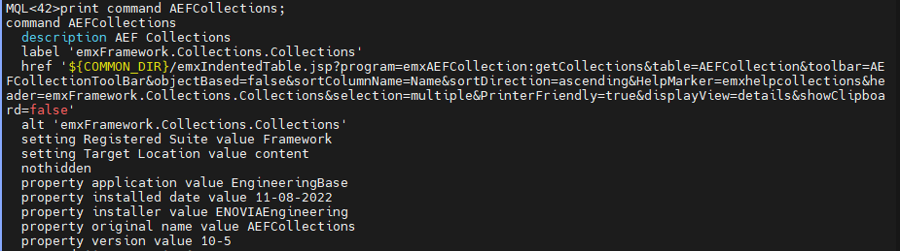
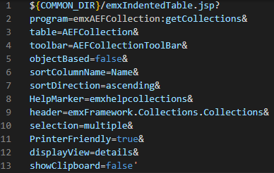
Customization I - client
UI Modeling – Table (${COMMON_DIR}/emxIndentedTable.jsp?)
)

Slide 25
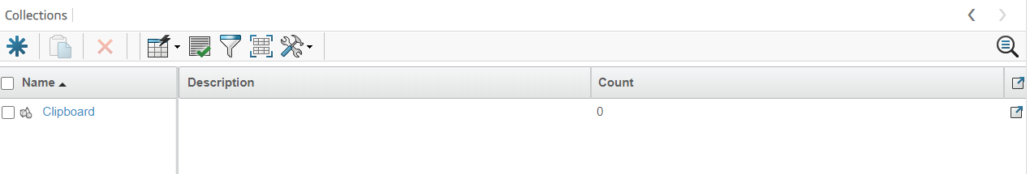
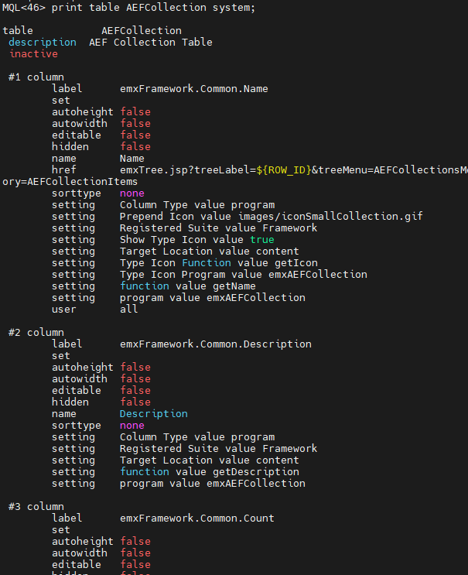
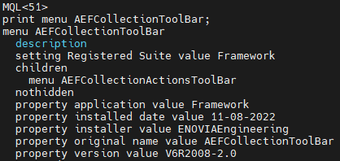
Customization I - client
UI Modeling – Table (${COMMON_DIR}/emxIndentedTable.jsp?)

Slide 26
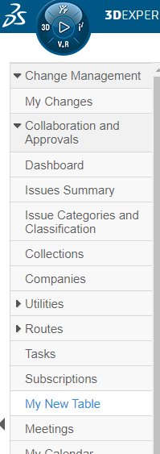
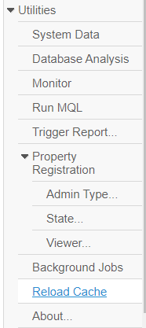
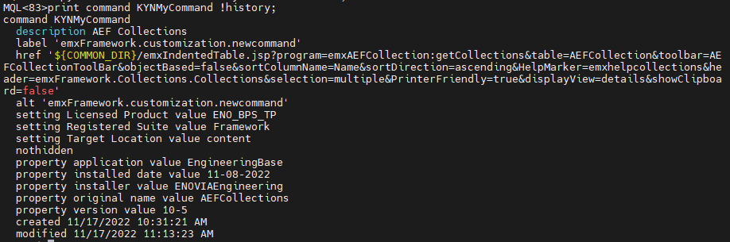
Customization I - client
UI Modeling – New Table UI 실습 – 메뉴 만들기
MQL<55>copy command AEFCollections KYNMyCommand;
MQL<56>modify menu "My Enovia" add command KYNMyCommand;
변경 Schema 반영
MQL<58>modify menu "My Enovia" order command KYNMyCommand 11;
MQL<59>modify command KYNMyCommand add setting "Licensed Product" ENO_BPS_TP;

Slide 27
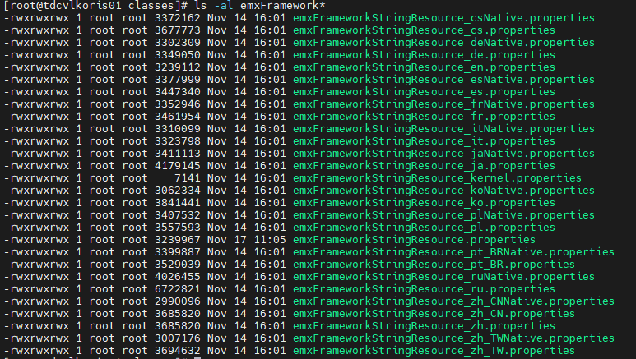
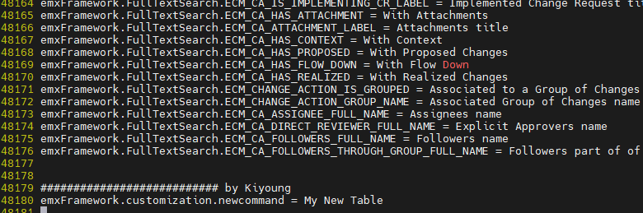
Customization I - client
UI Modeling – New Table UI 실습 – Multi Language 설정
MQL<82> add table KYNMyNewTable system column label "emxFramework.Common.Name" name "Name" href "emxTree.jsp?treeLabel=${ROW_ID}&treeMenu=AEFCollectionsMenu&AppendParameters=True&DefaultCategory=AEFCollectionItems" user all;

Slide 28
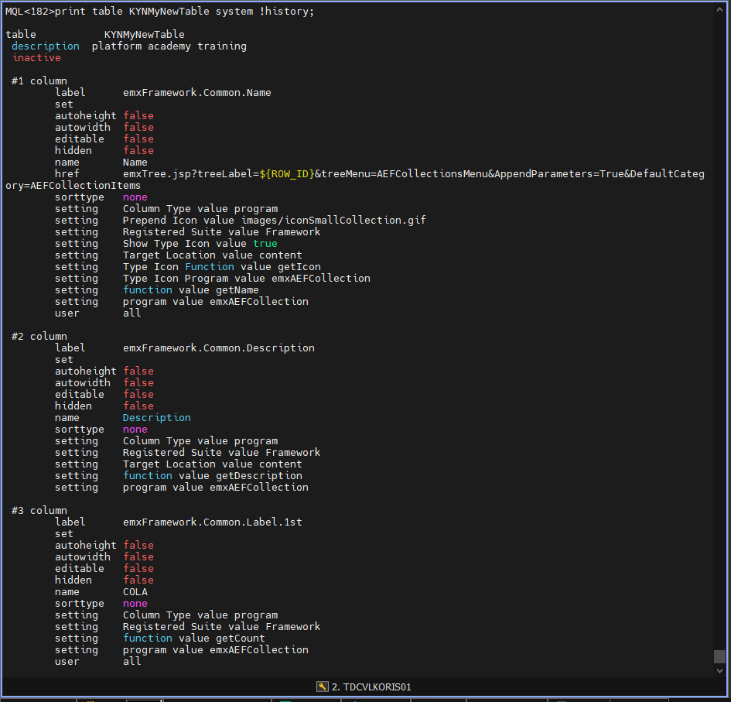
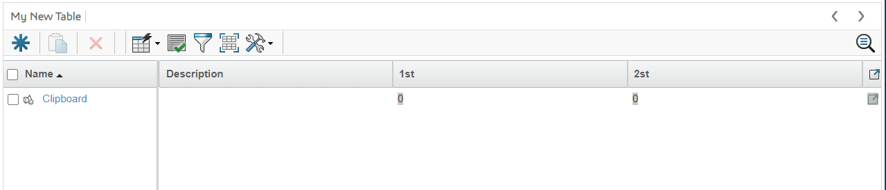
Customization I - client
UI Modeling – New Table UI 실습 – Column 설정
modify table KYNMyNewTable system column modify name Name
add setting "Column Type" program
add setting "Prepend Icon" "images/iconSmallCollection.gif"
add setting "Registered Suite" "Framework"
add setting "Show Type Icon" true
add setting "Target Location" content
add setting "Type Icon Function" getIcon
add setting "Type Icon Program" emxAEFCollection
add setting "function" getName
add setting "program" emxAEFCollection;

Slide 29
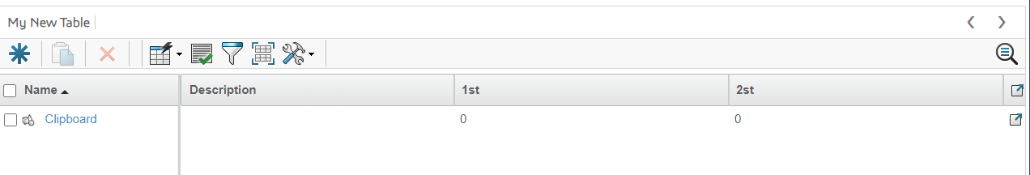
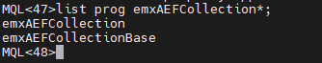
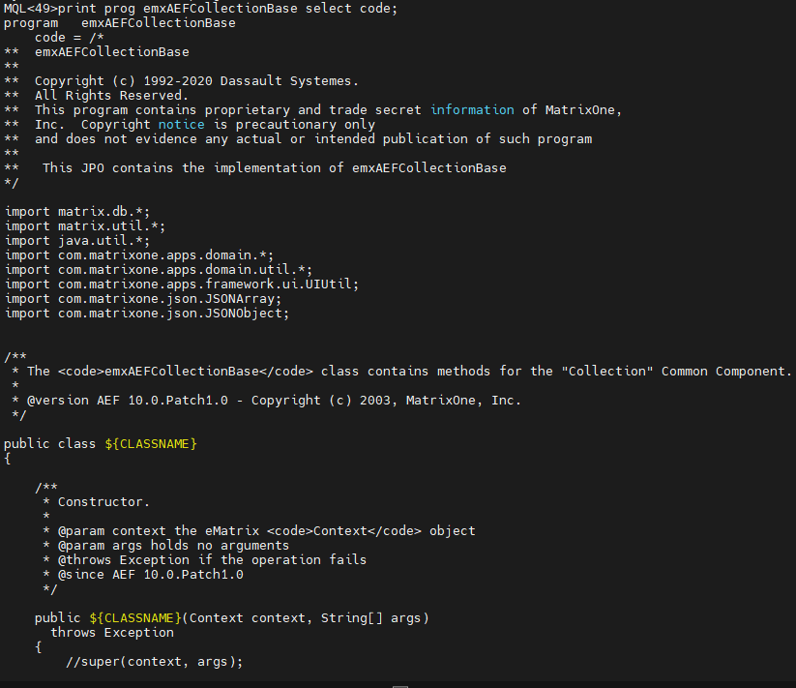
Customization I - client
UI Modeling – New Table UI 실습 – Table에 데이터 출력하기
@com.matrixone.apps.framework.ui.ProgramCallable
110 public MapList getCollections (Context context,String[] args)
111 throws Exception
112 {
113 MapList returnMapList = new MapList();
114 HashMap pMap = (HashMap)JPO.unpackArgs(args);
115 String strLang = (String) pMap.get("languageStr");
116
117 String sName = (String)pMap.get("Name");
118 boolean isSearch = false;
119 ArrayList patternList = new ArrayList();
120 /* Check for null if Navigation is from My Desk--> Collection */
121 if(sName != null) {
122 isSearch = true;
123 }
124
125 /* Build the Tokens for Pattern Matching */
126 if(isSearch) {
127 sName = sName.trim();
128 if("".equals(sName)) {
129 sName = "*";
130 }
131
132 if(sName.indexOf(",") != -1) {
133 StringTokenizer token = new StringTokenizer(sName, ",");
134 while(token.hasMoreTokens()) {
135 patternList.add(token.nextToken().trim().toUpperCase());
136 }
137 } else {
138 patternList.add(sName.toUpperCase());
139 }
140 }
141
142 return getCollectionList(context, strLang, isSearch, patternList);
143
144 }
145
${COMMON_DIR}/emxIndentedTable.jsp?program=emxAEFCollection:getCollections

Slide 30
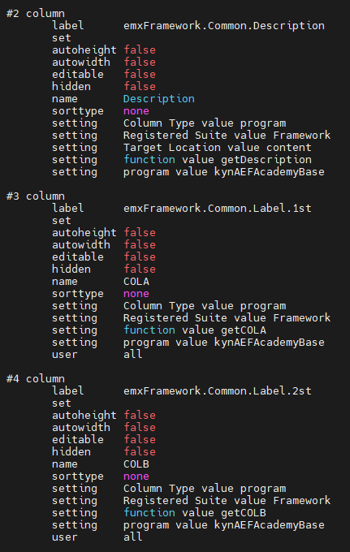
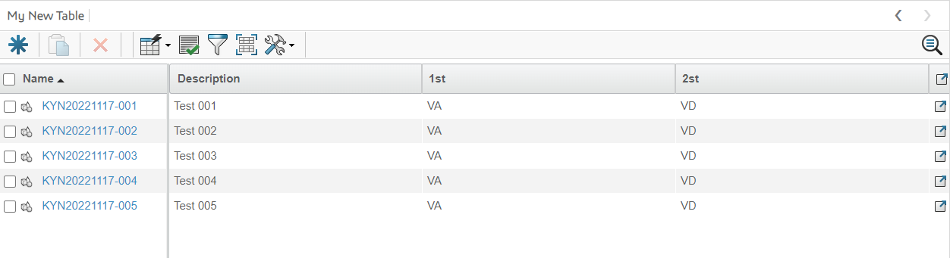
Customization I - client
UI Modeling – New Table UI 실습 – Table에 데이터 출력하기
MQL<264>extract prog kynAEFAcademyBase source ./;
MQL<264>insert prog kynAEFAcademyBase;
MQL<265>compile prog kynAEFAcademyBase force update;

Slide 31

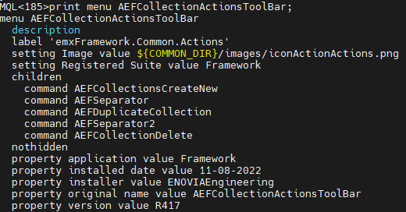
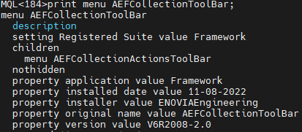
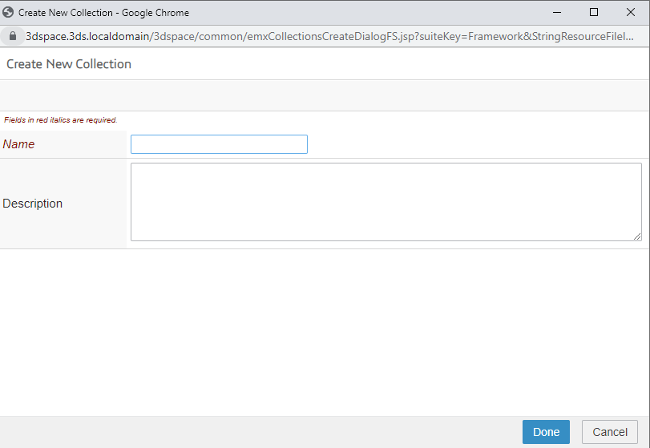


Customization I - client
UI Modeling – 생성 화면 만들기

Slide 32


Customization I - client
UI Modeling – 생성 화면 만들기 (Client Program)
Bottom
Header
emxXXXXXDialog.jsp
emxXXXXXProcess.jsp
Done
emxXXXXXDiaFS.jsp

Slide 33




Customization I - client
UI Modeling – 생성 화면 만들기 (form 이용하기)

Slide 34

Customization I - client
UI Modeling – 생성 화면 만들기 (form 이용하기)

Slide 35

Customization I - client
UI Modeling – 생성 화면 만들기 (business object creation using JPO)

Slide 36





Customization I - client
UI Modeling – 수정 화면 만들기

Slide 37


Customization I - client
UI Modeling – 수정 화면 만들기

Slide 38
Customization II - server

Slide 39



Customization I - server
Name를 자동으로 할당하기 - Number Generator
Number
Generator
Object
Generator
mod prog eServiceSchemaVariableMapping.tcl add property type_KYNType to type KYNType;

Slide 40
Customization I - server
public void autoAssociateECO(Context context, String[] args)
throws Exception
{
StringList objectSelects = new StringList(1);
objectSelects.addElement(DomainObject.SELECT_ID);
MapList objList = getRelatedObjects( context,
RELATIONSHIP_ECO_CHANGEREQUESTINPUT,
TYPE_ECO,
objectSelects,
null,
true,
false,
(short)1,
null,
null);
// Don't cause post processing if there is already an ECO
// associated with this ECR
//
if (objList.size() <= 0)
{
String commandName = args[0];
String objectId = args[1];
StringBuffer processStr = new StringBuffer();
processStr.append("JSP:postProcess");
processStr.append('|');
processStr.append("commandName=");
processStr.append(PropertyUtil.getSchemaProperty(context,commandName));
processStr.append('|');
processStr.append("objectId=");
processStr.append(objectId);
emxContextUtil_mxJPO.mqlNotice(context, processStr.toString());
}
}
연결 정보 가져오기
String POLICY_CONFIGURED_PART = PropertyUtil.getSchemaProperty(context,"policy_ConfiguredPart");
String STATE_PART_SUPERSEDED =PropertyUtil.getSchemaProperty(context,"policy",POLICY_CONFIGURED_PART,"state_Superseded");
whereExpression += " && "+SELECT_CURRENT+" != '"+STATE_PART_OBSOLETE+"' && "+SELECT_CURRENT+" != '"+STATE_PART_SUPERSEDED+"'";
String SELECT_TARGET_RELEASE_DATE = "attribute[" + PropertyUtil.getSchemaProperty(context,"attribute_EffectivityDate") + "]";
StringList objectSelects = new StringList();
objectSelects.add(DomainConstants.SELECT_ID);
objectSelects.add(DomainConstants.SELECT_CURRENT);
objectSelects.add(DomainConstants.SELECT_TYPE);
objectSelects.add(DomainConstants.SELECT_POLICY);
objectSelects.add(SELECT_TARGET_RELEASE_DATE);
//Fix IR-678353-3DEXPERIENCER2018x
String queryLimit = PartMgtUtil.getPropertyValue(context, "emxEngineeringCentral.Part.Channel.QueryLimit");
MapList mapList= DomainObject.findObjects(context, selType,
QUERY_WILDCARD, // namepattern
QUERY_WILDCARD, // revpattern
"*", // owner pattern
QUERY_WILDCARD, // vault pattern
whereExpression, // where exp
null,
true, objectSelects,PartMgtUtil.getValueInShort(queryLimit),null,null,new StringList(),new StringList("-modified"));
int listSize = mapList.size();
Map<String,String> map;String type;
if(excludeTypes != null && excludeTypes.size() > 0 && listSize > 0) {
for(int i=0;i<listSize;i++) {
map = (Map<String,String>)mapList.get(i);
type= map.get(SELECT_TYPE);
if(!excludeTypes.contains(type)) {
finalList.add(map);
}
}
return finalList;
}
return mapList;

Slide 41
Customization I - server
public boolean connectCompany (Context context, String[] args) throws Exception {
// Check license while creating Program, if license check fails here,the programs will not be created.
ComponentsUtil.checkLicenseReserved(context,ProgramCentralConstants.PGE_PRG_LICENSE_ARRAY);
boolean allowConnection = false;
try{
Map map = JPO.unpackArgs(args);
Map paramMap = (Map)map.get("paramMap");
Map requestMap = (Map)map.get("requestMap");
String objectId = (String) paramMap.get("objectId");
String programName = (String) requestMap.get("Name");
DomainObject program = DomainObject.newInstance(context, objectId);
Company company = com.matrixone.apps.common.Person.getPerson(context).getCompany(context);
StringList objSelect = new StringList();
objSelect.add(ProgramCentralConstants.SELECT_PHYSICALID);
Map companyInfo = company.getInfo(context, objSelect);
String revision = (String)companyInfo.get(ProgramCentralConstants.SELECT_PHYSICALID);
String sCommandStatement = " modify bus $1 name $2 revision $3";
MqlUtil.mqlCommand(context, sCommandStatement,objectId, programName,revision);
String tempQuery = " temp query bus $1 $2 $3 select $4 dump $5";
String result = MqlUtil.mqlCommand(context, tempQuery,"Program", programName,revision,"id","|");
if (ProgramCentralUtil.isNotNullString(result) && result.indexOf("\n") != -1) {
allowConnection =false;
}else{
// connect to the company.
DomainRelationship.connect(context,
company,
DomainConstants.RELATIONSHIP_COMPANY_PROGRAM,
program);
allowConnection =true;
}
} catch (Exception e) {
throw new MatrixException(e);
}
return allowConnection;
}
데이터 생성 (New bus/connection 생성)
try {
ContextUtil.startTransaction(context, true);
String sName = DomainObject.getAutoGeneratedName(context, "type_KYNType", "");
doNew.createObject(context, sType, sName, "", sPolicy, "eService Production");
busId = doNew.getId(context);
doNew.setDescription(context,sDesc);
doNew.setAttributeValue(context,"kynAtt02",sAttr01) ;
doNew.setAttributeValue(context,"kynAtt03",sAttr02) ;
returnMap.put(ChangeConstants.ID, busId);
ContextUtil.commitTransaction(context);
} catch (Exception e) {
ContextUtil.abortTransaction(context);
e.printStackTrace();
throw new FrameworkException(e);
}
return returnMap;

Slide 42





Customization I - server
Deliverable

Slide 44
Appendix. tips
MQL<264>mod bus XXXX.XXX.XX owner admin_platform project Default organization "Company Name";

